Slide 1


BGSW- SJCE Faculty Development Program 2023
Security Architecture
Vijay Kulkarni

Slide 2

Expectation
  Learn about security architecture
  Get familiar with internal architecture of HSM
  Understand the HSM & Software Crypto Libraries.
Notes:
Align with schedule or plan

Slide 3
Agenda
  Motivation for Introducing Hardware Security Module.
  Introducing Hardware Security Modules (HSM) to Embedded Systems.
  Software and Hardware solutions.
  Criteria to choose SW Crypto Libraries.
Notes:
Align with schedule or plan

Slide 4
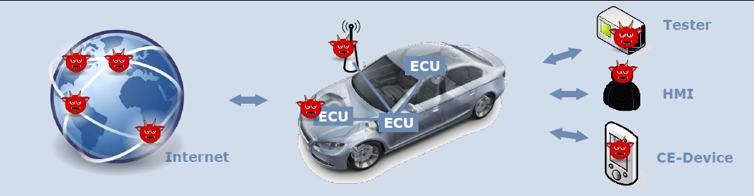
Security Architecture
Motivation for introducing Hardware Security Module.
Attack surface is growing
  Car networks get connected to the internet
  CE-Devices are connected to the car networks
  Network access hardware and software is now cheap (e.g. bluetooth – CAN)
Growing complexity of the in-car software, 3rd party SW integration
Attackers are becoming more professional, using more advanced methods
Increasing value of features that are activated and controlled by software.
To provide the necessary trust primitives and resistance to physical attacks, the security mechanisms must be rooted in hardware.
Bosch decision: Set high standard for security in ECU platforms!

Slide 5
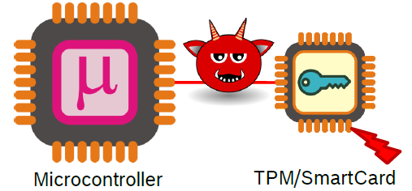
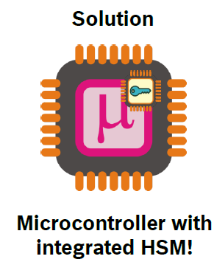
Security Architecture
Motivation for introducing Hardware Security Module.
Using an external TPM (Trusted Platform Module) ?
Initial idea: Use an existing component-of-the-shelf like a TPM or SmartCard as root-of-trust
But …
Cost, PCB area
Quality requirements, availability of suitable components
Sensitivity to valid attacks
  Reset attack (TPM is reset, manipulated uc continues operation)
  Data exchanged between uC and TPM is not protected)

Slide 6
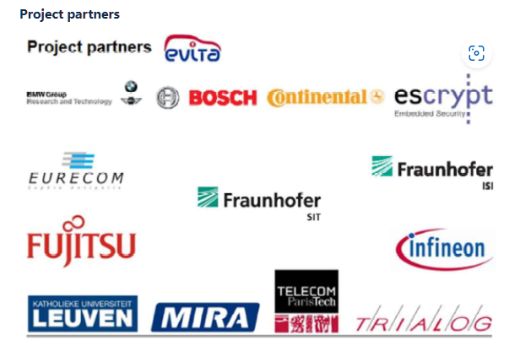
Security Architecture
Hardware Security Module in context
History
Developed in EU-sponsored project EVITA
  EVITA: E-Safety Vehicle Intrusion Protected Applications
  A proof-of-concept project led and funded by European Union, delivered as a prototype
Consortium: Robert Bosch, BMW, Infineon, …
Specs available via the EVITA web site
EVITA HSM profiles
HSM full
HSM medium
HSM small

Slide 7
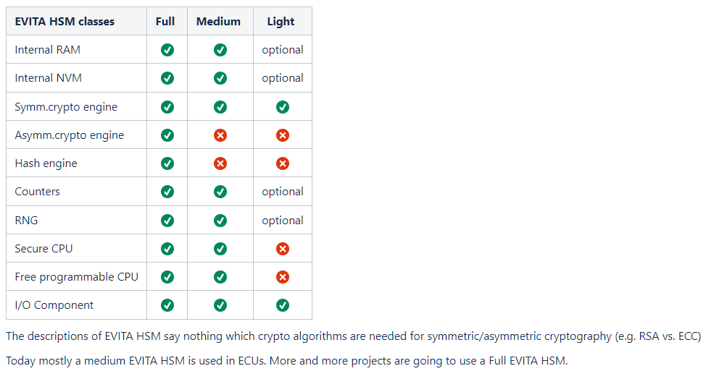
Security Architecture
Hardware Security Module in context

Slide 8
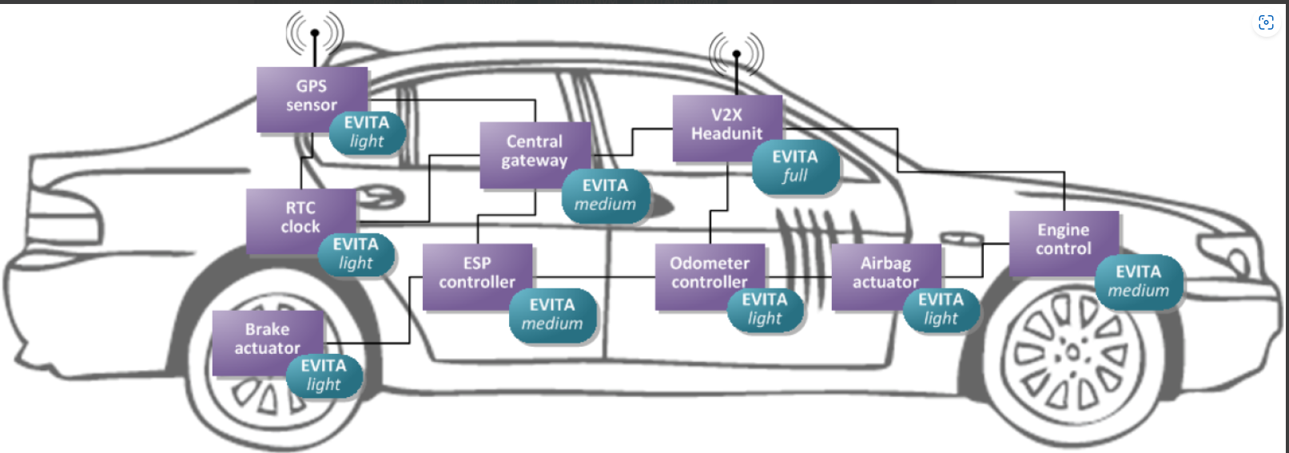
Security Architecture
In-vehicle ECUs are secure enhanced by different EVITA HSMs.

Slide 9
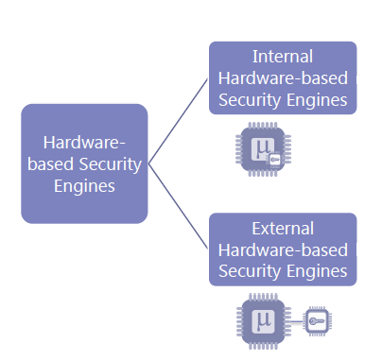
Security Architecture
In general security architecture broadly divided into Internal hardware-based security engines and external hardware-based security engines which are capable of doing the security functions viz. Key storage, TRNG, crypto operations.
Off-Chip HSM | On-Chip HSM
Connected via bus system | Within chip housing
Slower than internal memory | Short connection: fast access
Easier to access illegitimately | Hard to access illegitimately
High capacity | Small, low capacity
Cheap | Expensive
Source : Escrypt

Slide 10
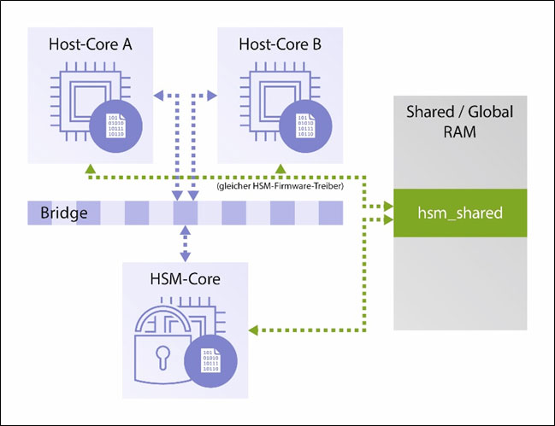
Security Architecture
Introducing Hardware Security Modules (HSM) to Embedded Systems.
Internal Hardware-based security engines (HSM)
Source : Escrypt
HSM acts as internal security backbone or root of trust for all the security operations.

Slide 11
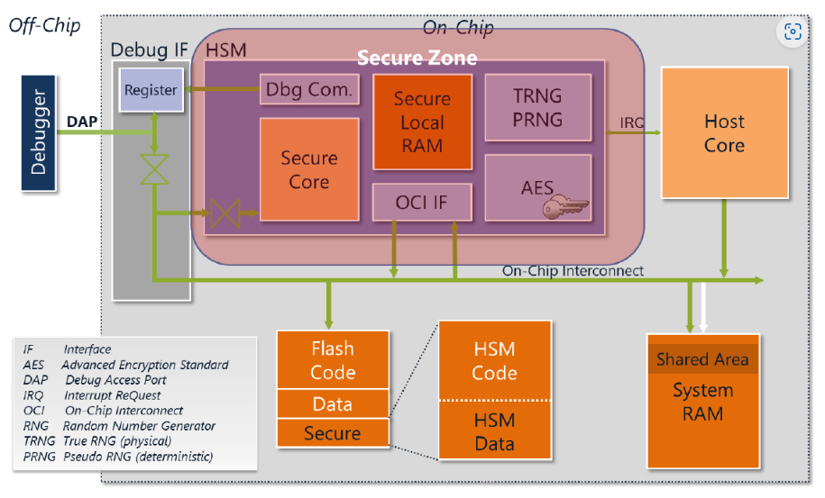
Security Architecture
High Level Architecture of the hardware security module (HSM)
Source : Escrypt

Slide 12
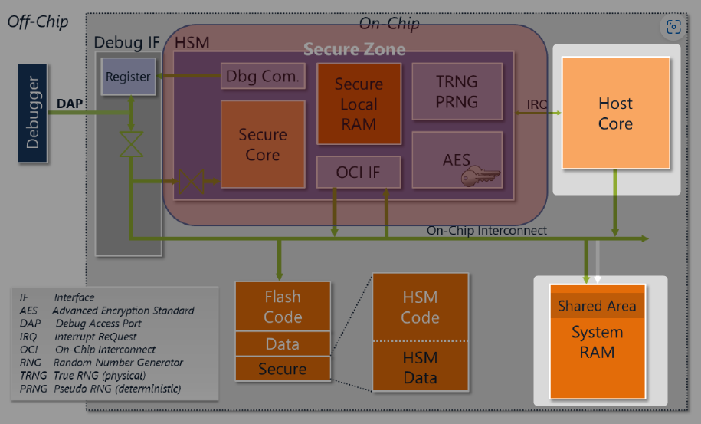
Hardware Architecture of the hardware security module (HSM)
Host Core
Host core is the CPU core on which the general application of the microcontroller is running.
There can be more than one main core on the microcontroller.
This is not a part of HSM but has been specified here because of its importance.
Most of the use cases are performed in the main core and HSM communicated with outside through main core.
System RAM
System RAM is the main RAM of the main core & can also be read by HSM
A specific part of system RAM is shared RAM such that HSM can also write to this part.
This part is used for fast data exchange between HSM and the main core.

Slide 13
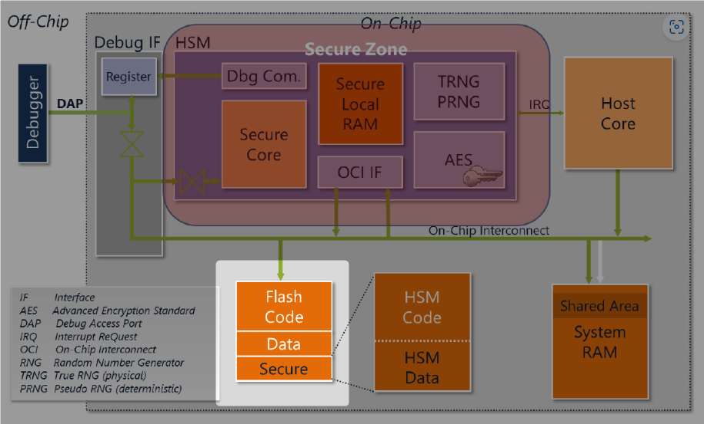
Hardware Architecture of the hardware security module (HSM)
Flash
The system flash is partitioned into two parts of main (or unprotected) flash and the secure flash.
The unprotected part is readable and writeable by the main core but only readable by HSM.
The secure part of flash is both readable and writeable by HSM.
By means of hardware measures, part of the flash is shielded and can be made available exclusively to HSM (denoted as ‘Secure’). HSM flash is split and dedicated into code & data flash.

Slide 14
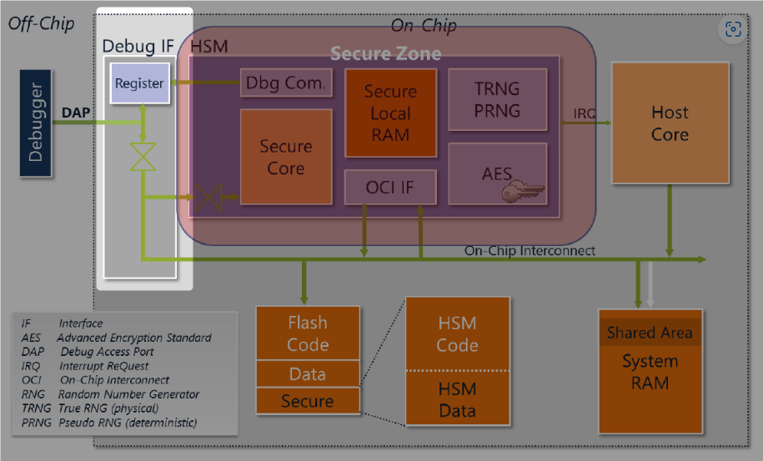
Hardware Architecture of the hardware security module (HSM)
Debug Com/Interface
Debug Interface provides the possibility to debug the system.
Since, debugging the system has big impact on the security of the system, it is important to protect it against unauthorized access.
A user can be authorized to debug the main core or both the main core and HSM. The protection of the debug port is applied by HSM.
Opening the debug port is done using an asymmetric challenge/response protocol in which the debugger provides a certificate to HSM.

Slide 15
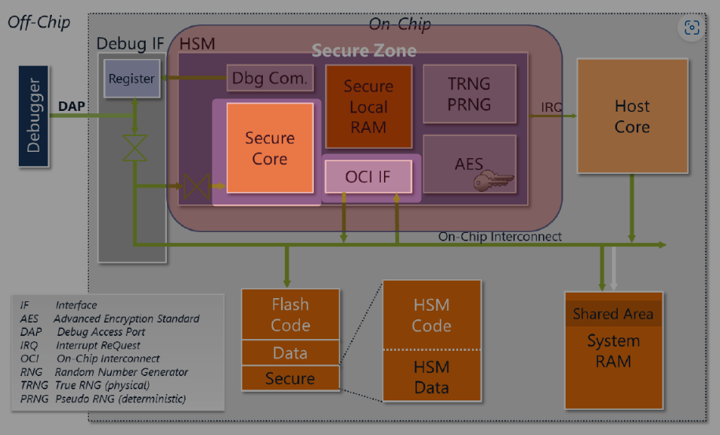
Hardware Architecture of the hardware security module (HSM)
Secure Core
Secure core is a 32-bit CPU core, which is main processing unit of HSM. This core can work with a clock frequency upto atleast 60Hz(depends on semi-conductor vendor).
This core supports the two user and supervisor modes of operation.
Different parts of memory (volatile or non-volatile) can be protected in such a way that they
can be accessed only in the supervisor mode. Different operations which can be denied in the user mode are read, write, and execute.
OCI-IF
Via On-Chip Interconnect interface, the HSM has access to flash memory which is shared with the host.
Via On-Chip Interconnect the HSM also has access to the system RAM, there fore the software executing on the secure core can communicate with software executing on the host core(s) by means of shared memory communication (IPC).

Slide 16
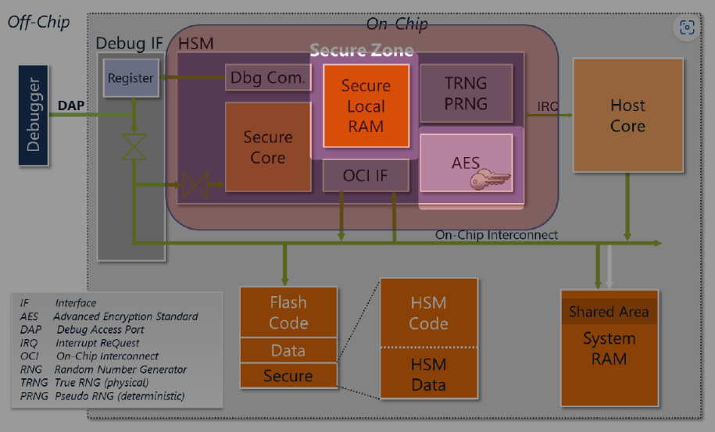
Hardware Architecture of the hardware security module (HSM)
Secure Local RAM
Secure Local RAM is the dedicated volatile storage of HSM which is used to store temporary variables.
This part of memory is only accessible to secure core.
The main core has neither read nor write access to it.
Typical size of HSM secure local ram is atleast 24KBytes.
AES – Advance Encryption Standard
(Hardware Cryptography Accelerator)
As it is evident from the name, Hardware Cryptography Accelerator is used to accelerate the cryptography operations for which the secure core/Host-core is not fast enough.
This module implements minimally the AES encryption and decryption of 128-bit blocks using 128-bit keys and the CMAC mode of operation in hardware.

Slide 17
Hardware Architecture of the Hardware security module (HSM)
True Random Number Generator (TRNG)
Pseudo Random Number generator (PRNG)
Used for generating cryptographic keys.
Randomization of cryptographic operations & protocols.
What are the difference between TRNG & PRNG ?
Which one is more predictable ?
Software-generated random numbers only are pseudorandom. They are not truly random because the computer uses an algorithm based on a distribution, and are not secure because they rely on deterministic, predictable algorithms.
For truly random numbers, the computer must use some external physical variable that is unpredictable, such as entropy source (atmospheric noise, noise produced by current flowing in a transistor, or the time between radio active decay events etc)

Slide 18
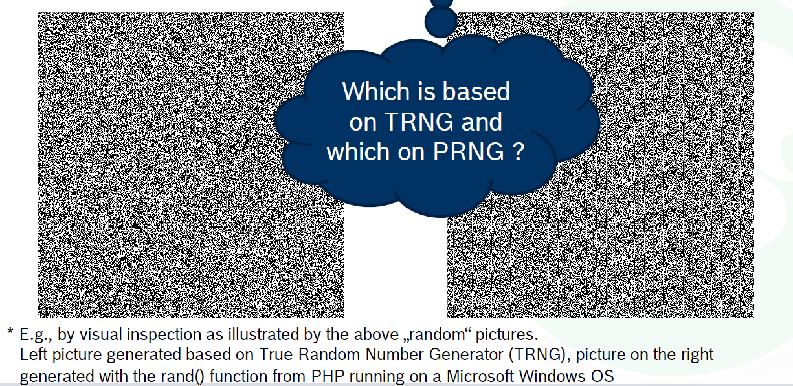
Security Architecture
Case Study – Good vs Bad randomness
In rare cases, it is easy* to distinguish „good“ from „bad“ randomness…

Slide 19
Topics covered so far
  Motivation for Introducing Hardware Security Module.
  Introducing Hardware Security Modules (HSM) to Embedded Systems.
  Hardware and Software solutions.
  SW Crypto Libraries.
Notes:
Align with schedule or plan

Slide 20


HW solutions and SW solutions
HW solutions
Hardware Security module [HSM]
Hardware Trust Anchors (HTA)
  Protect sensitive data (e.g., crypto material) in ways that software can not manipulate.
  Provide crypto functions (e.g., signature generation) to unburden the host controller.
  Storage of keys and certificates.
TRNG.
HW acceleration of crypto. Functions.
HTAs protect memory, so only authorized persons can access Certificates and Private Keys
Various capabilities depending on domain and use case
  Secure Hardware Extension (SHE).
  Hardware Security Module (HSM).
  Trusted Platform Module (TPM).
Different brand names for HTA by different HW suppliers.
  Infineon: Aurix HSM / SHE+ driver.
  Renesas: Intelligent Cryptographic Unit (ICU).
  Freescale: Crypto Service Engine (CSE).
  ARM: Trust Zone.

Slide 21
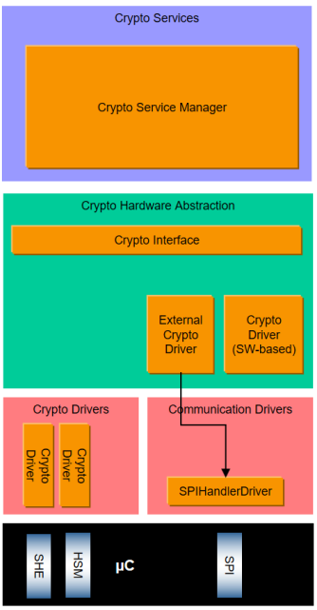
HW solutions and SW solutions
SW solutions
AUTOSAR 4.3 SW Security Architecture & interfaces
Crypto Service Manager – CSM
  Services can be called by SWCs.
  Configuration of cryptographic services.
Crypto Interface – CRYIF
  Supports dispatching of security jobs to HW or SW crypto drivers.
Crypto Driver – CRYDRV
  Implementation of cryptographic functions.
  Either in SW or HW (HTA).
CRC – Cyclic redundancy check
E2E – End to End communication protection
CAL – Cryptographic Abstraction Layer
CPL – Cryptographic primitive later

Slide 22
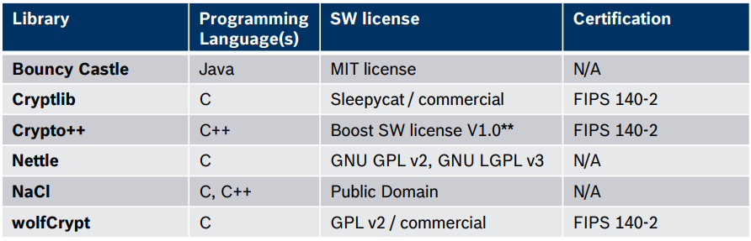
HW solutions and SW solutions
SW solutions
SW crypto Libraries
A cryptographic library is a software library dealing strictly with cryptographic algorithms/functions*.
Usually, a cryptographic library offers API function calls to each of its supported features
Limited/Compromised Security implementation.
Autosar solution -> CAL module (provides API’s)
Examples of open-source libraries (according to Wikipedia)
*SW based solution for Crypto functions.
  Cryptographic basic functions (PRNG, Hash)
  Supporting signature generation and verification.
  Implementation of cryptographic routines like AES, RSA etc.

Slide 23
HW solutions and SW solutions
SW solutions
Criteria for choosing suitable library
Security qualification, e.g., secure coding guideline, security certification, security patching.
Safety qualification, e.g., in compliance with MISRA C or ISO26262 (ASIL).
Efficiency and portability, e.g., performance optimization and platform compatibility (in particular for use in embedded devices).
Coverage, e.g., supported algorithms or programming languages.
General code quality and documentation.
Licensing model, e.g., commercial product vs. open source.
Service and support, e.g., continuous maintenance and integration support .

Slide 24
HW solutions and SW solutions
Comparison - freeware vs. Standard Cryptolib
Freeware cryptographic library | Standard* Cryptographic library
? May be well test | ☑ Well tested
? May be licensed under GPL | ☑ GPL free
X No product support | ☑ Long-term product support and maintenance
X No customer incident handling & support | ☑ Customer incident handling and support
X Not qualified for automotive systems and microcontrollers | ☑ Qualified for automotive systems and microcontrollers
Key Message
Ask for support when choosing cryptographic library!
Make use of Standard* libraries available!
Standard cryptolib
Escrypt CycurLIB,

Slide 25
HW solutions and SW solutions
The Trade off
Hardware Encryption : Hardware encryption uses a separate processor dedicated to the task of authentication and encryption. Hardware encryption is increasingly common on mobile devices. E.g. Finger touch in mobile
The technology still relies on a special key to encrypt and decrypt data, but this is randomly generated by the encryption processor. Often, hardware encryption devices replace traditional passwords with biometric logons (like fingerprints) or a PIN number that is entered on an attached keypad.
Pros: Hardware encryption is safer than software encryption because the encryption process is separate from the rest of the machine. This makes it much harder to intercept or break.
Cons: Typically, hardware-based encrypted storage is much more expensive than a software tool. For instance, BitLocker is included for free with all new versions of Microsoft Windows, but an encrypted USB thumb drive is quite expensive, especially when compared to an unencrypted alternative.

Slide 26
HW solutions and SW solutions
The Trade off
Software Encryption: As the name implies, software encryption uses software tools to encrypt your data. e.g: Bit locker of windows
Software encryption typically relies on a password; give the right password, and your files will be decrypted, otherwise they remain locked. With encryption enabled, it is passed through a special algorithm that scrambles your data as it is written to disk. The same software then unscrambles data as it is read from the disk for an authenticated user.
Pros: Software encryption is typically quite cheap to implement, making it very popular with developers. In addition, software-based encryption routines do not require any additional hardware.
Cons: Software encryption is only as secure as the rest of our computer or smartphone. If a hacker can crack your password, the encryption is immediately undone.

Slide 27

Your questions are welcome!
Thank you!

